Slide 1
Team Correct
Show and Tell

Slide 2
Our Users
Social media users
People who read English news
Anxious about content behind a link
All age groups
Interested in the standard of current news stories

Slide 3
Website Back-End
Score | Type
1 | Fake
2 | Unreliable
3 | Conspiracy
4 | Satire
5 | Hate
6 | Bais
7 | Junk
8 | Political
9 | Clickbait
10 | Reliable
URLs are stored in DB and assigned with a scoring
Web scraping, Heading, image, 1st Paragraph, URL
Score cards
News Headings match with other reliable sources
Word Count, Grammar, Date, Author
Sub URLs
Adverts

Slide 4
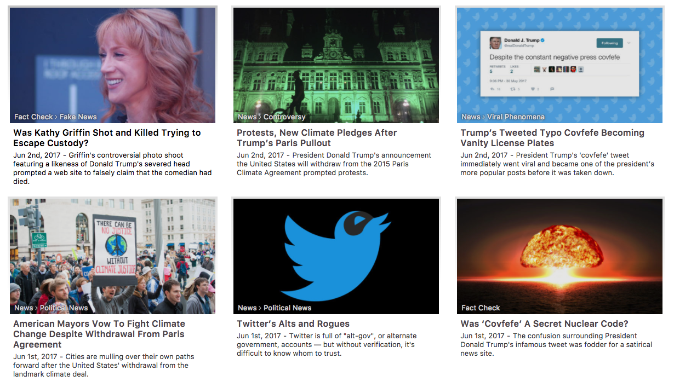
Websites Front-End
Search box to find news headings
Navigation bar on news URLs
Shown content from sky News twitter/FaceBook
FAQs
Search box to identify URLs
Unrecognized URLs are rated by users with type
News share option, not trusted, error message
Display content by web scraping region and currency
Way the news be displayed on the website on each page: Image, heading, first paragraph and URL

Slide 5




Our Challenges
Python, Django & Bootstrap
Database memory
Web Scraping (Beautiful Soup)

Slide 6
Thank You!
Questions?

